Slide 1
Global-to-Local GLOBIOM: Status
Michiel van Dijk
Interim presentation (10/05/2017)

Slide 2
Objective
Develop a methodology (‘pipeline’) to prepare GLOBIOM for local (=subnational) analysis
Focus on improvement of land cover and land use maps (input side)
Apply this to Zambezi and Indus river basins in the context of the ISWEL project

Slide 3
Features
Consistent – one approach that can be used for any subnational study
Bottom up – incorporating national agricultural statistics, household surveys and land cover information wherever possible
Coded – coded in R and GAMS for easy implementation and reproducibility
Documented – fully documented so that it can be reproduced in other projects

Slide 4
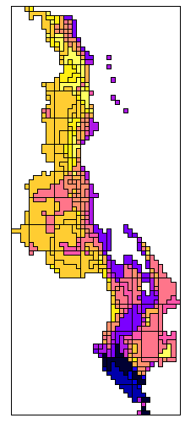
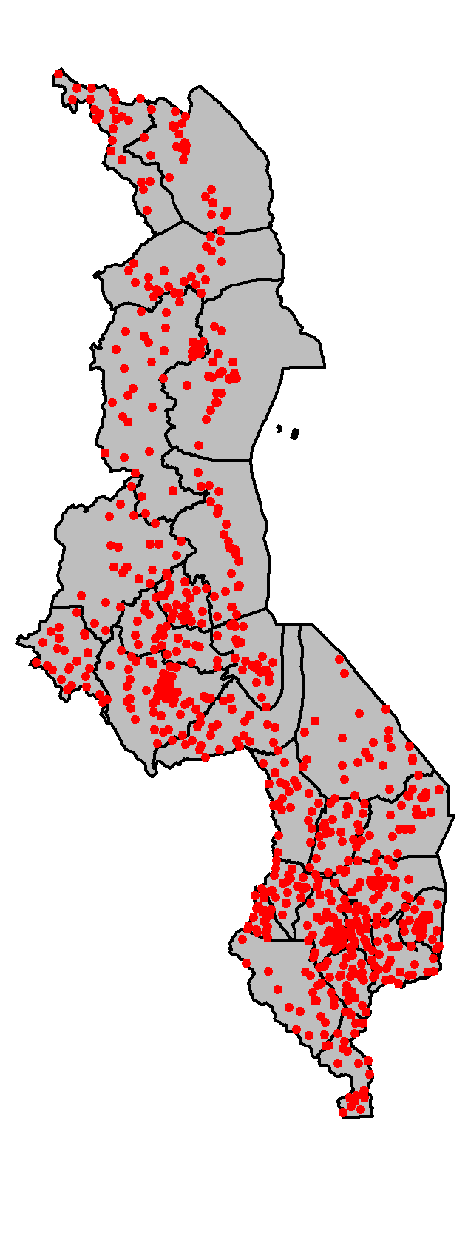
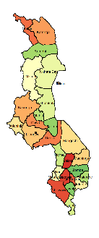
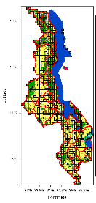


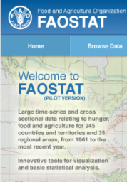
Methodology to allocate agricultural area
Simu land use map
Household surveys
Subnational statistics
Harmonistation
Downscaling
Land cover maps
FAOSTAT
County report

Slide 5
Country-level outputs
Land cover map
Land use map
Agricultural statistics at adm2 level
Country report
Data sources
Maps
Data tables
Comparison with FAOSTAT

Slide 6
Status: Malawi case-study
Data collection and cleaning
Completed
Data processing
R scripts to analyse and harmonise data (nearly) completed
Standard country report coded
Downscaling (in GAMS)
In process
Documentation
In process

Slide 7
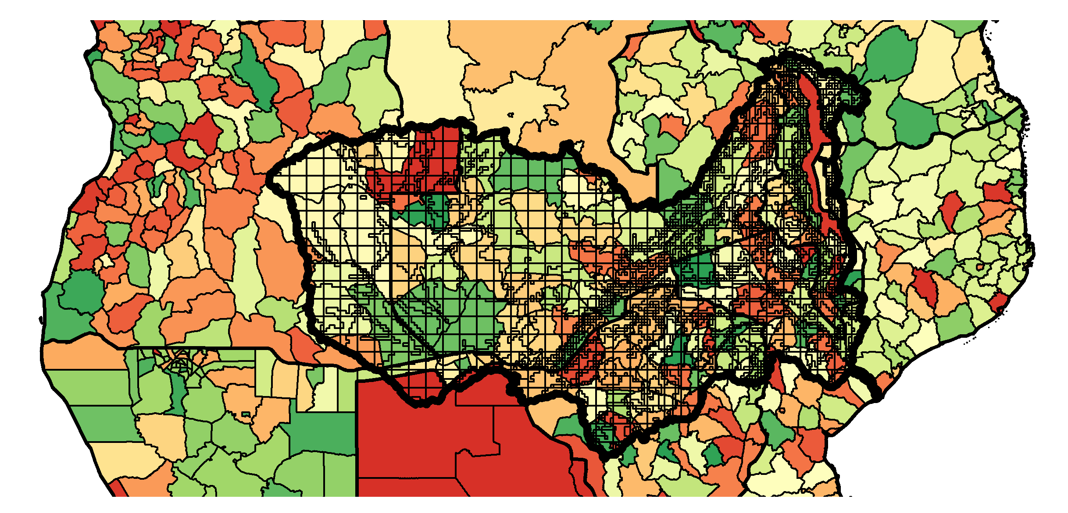
Zambezi river basin: Administrative regions versus simus

Slide 8
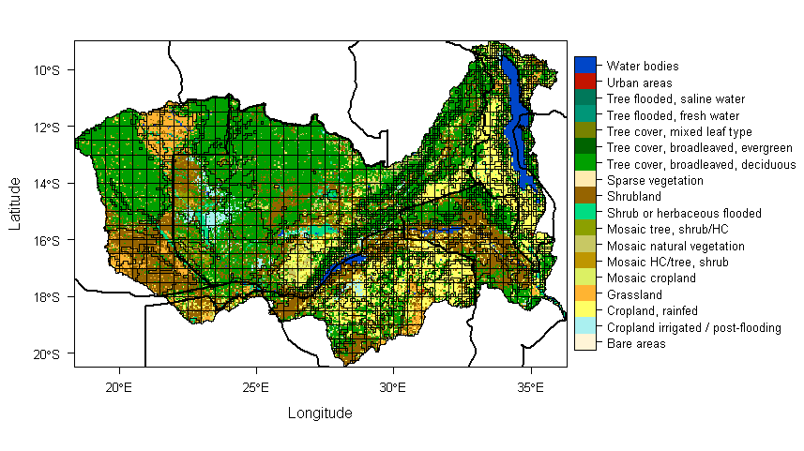
Zambezi river basin: Land cover versus simus

Slide 9
ISWEL: Proposed planning
May 2017: Prepare GLOBIOM for Zambezi (& Indus) analysis
May 2017: Finalise first complete version of Global-tot-local Globiom procedure (with application to MWI)
May-September 2017: Improve GLOBIOM with irrigation module – link with CWM
June-August 2017: Apply Global-to-local procedure to all Zambezi (&Indus) countries
June-August 2017: Test GLOBIOM with new data + case-study paper
September-December 2017: Conduct Zambezi (& Indus) analysis with GLOBIOM

